Slide 1

Big Data Applied Algorithms
Lecture 2
Rong-Hua Li
School of Computer Science & Technology
Beijing Institute of Technology

Slide 2

Course Information
Tuesday and Friday
中文班 9:55-11:30 研究生楼208
English Class 13:20-14:55 研究生楼606
Grade: 50% final exam, 50% Homework (or quiz)
Recommended Books (PDF available: http://dimacs.rutgers.edu/~graham/ssbd.html)

Slide 3

This lecture
Sampling and counting sketches:
Uniform Reservoir sampling
Uniform bottom-k sampling
Distinct sampling
Distinct counting
MinHash Sketch variety
Distinct count estimators (and introduction to estimation methods)
Analysis/Derivation Tools: Bounds on quality of estimates, The Exponential distribution, Maximum Likelihood, Inverse Probability, Cramer Rao, Sufficient statistics

Slide 4

Quality of estimates
Bounds on the probability that a random variable deviates from its expectation
Markov Inequality (nonnegativity assumption)
Random variable $X≥0$: for any $c>0$, $Pr\left[X>c E[X]\right]<\frac{1}{c}$
Proof: Contribution to expectation when $X>cE\left[X\right]$ is: $E\left[X\right]≥ Pr\left[X>cE\left[X\right]\right]⋅cE[X]$
Chebyshev inequality (using variance)
Random variable $X$with variance $σ^{2}$, for any $c≥0$: $Pr\left[\left|X−E[X]\right|≥cσ\right]≤\frac{1}{c^{2}}$
Proof: Apply Markov with r.v. $Y={\left(X−E\left[X\right]\right)}^{2}$ and $c^{′}=c^{2}$. Note that $E\left[Y\right]=σ^{2}$
$$Pr\left[\left|X−E\left[X\right]\right|>cσ\right]=Pr\left[Y>c^{2}σ^{2}\right]=Pr\left[Y>c^{′}E\left[Y\right]\right]≤\frac{1}{c^{′}}=\frac{1}{c^{2}}$$

Slide 5
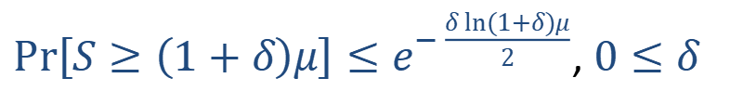
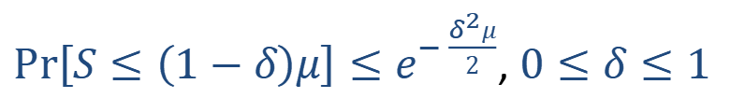
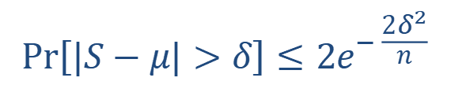
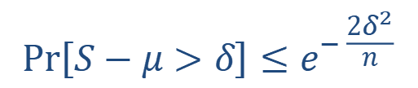
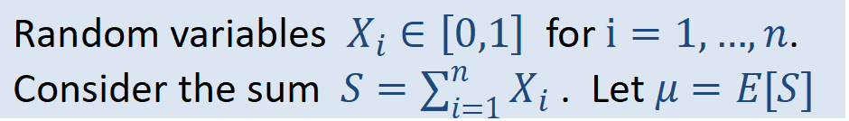
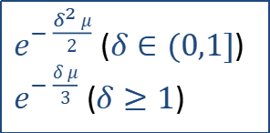
Quality of estimates: Chernoff/Hoeffding/Bernstein concentration bounds
Bound the probability that a sum of independent* random variable deviates from its expectation
Random variables $X_{i}∈\left[0,1\right]$ for $i=1,…,n$.
Consider the sum $S=\sum_{i=1}^{n}{X_{i}}$ . Let $μ=E[S]$
Hoeffding Bounds (additive error)
$$Pr\left[S−μ>δ\right]≤e^{− \frac{2δ^{2}}{n}}$$
$$Pr\left[|S−μ|>δ\right]≤{2e}^{− \frac{2δ^{2}}{n}}$$
$e^{− \frac{δ^{2} μ}{2}}$ ($δ∈(0,1]$)
$e^{− \frac{δ μ}{3}}$ ($δ≥1$)
Chernoff Bounds (multiplicative error)
$Pr\left[S≤\left(1−δ\right)μ\right]≤e^{− \frac{δ^{2}μ}{2}}$, $0≤δ≤1$
$Pr\left[S≥\left(1+δ\right)μ\right]≤e^{− \frac{δ ln(1+δ)μ}{2}}$, $0≤δ$
Proof method: To bound $Pr[Y>a]$ consider $Pr[e^{tY}>e^{ta}]$ instead. Apply Markov’s inequality, and optimize over $t$ to obtain the tightest result.
*Suffices to bound expectation of products of $X_{i}$ and ${(1−X}_{i})$ by that of independent

Slide 6
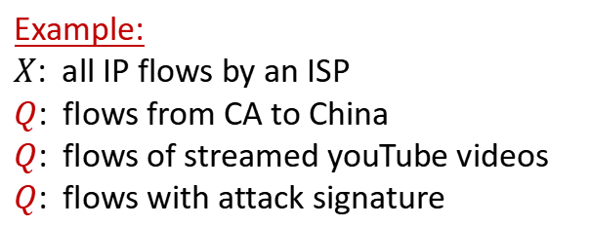
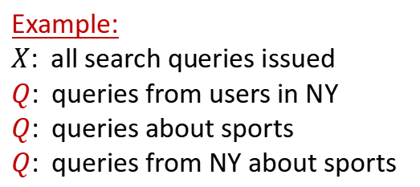
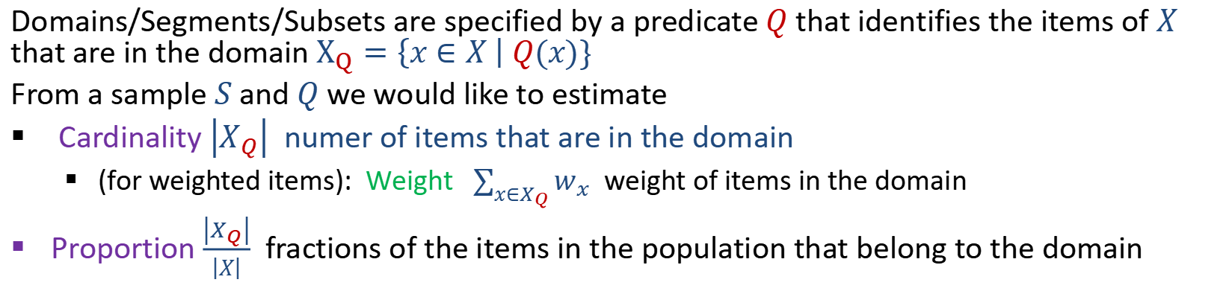
Random samples
Powerful method for data analysis: Efficiently estimate properties of a large population $X$ by examining a small sample.
Domains/Segments/Subsets are specified by a predicate $Q$ that identifies the items of $X$ that are in the domain $X_{Q}=\left\{x∈X \right| Q(x)\}$
From a sample $S$and $Q$ we would like to estimate
Cardinality $\left|X_{Q}\right|$ numer of items that are in the domain
(for weighted items): Weight $\sum_{x∈X_{Q}}{w_{x}}$ weight of items in the domain
Proportion $\frac{\left|X_{Q}\right|}{\left|X\right|}$ fractions of the items in the population that belong to the domain
Example:
$X$: all search queries issued
$Q$: queries from users in NY
$Q$: queries about sports
$Q$: queries from NY about sports
Example:
$X$: all IP flows by an ISP
$Q$: flows from CA to China
$Q$: flows of streamed youTube videos
$Q$: flows with attack signature

Slide 7
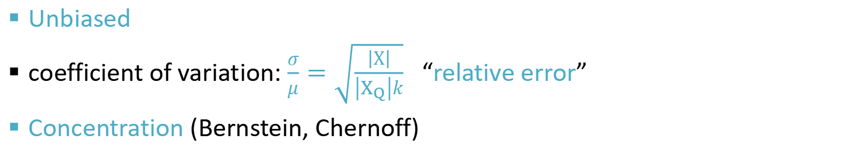
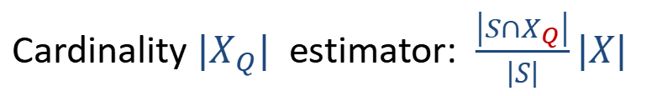
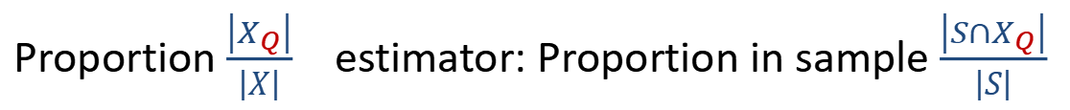

Uniform sampling
All items have the same inclusion probability
Bernoulli sampling: Independent with fixed probability $p$ (variable size)
Fixed size $k$: All subsets of size $k$ equally likely
With replacement
Without replacement
!! For large scale streamed/distributed data, better to specify size
Proportion $\frac{\left|X_{Q}\right|}{\left|X\right|}$ estimator: Proportion in sample $\frac{\left|{S∩X}_{Q}\right|}{\left|S\right|}$
Cardinality $|X_{Q}|$ estimator: $\frac{\left|{S∩X}_{Q}\right|}{\left|S\right|}|X|$
Unbiased
coefficient of variation: $\frac{σ}{μ}=\sqrt{\frac{\left|Χ\right|}{\left|X_{Q}\right|k}}$ “relative error”
Concentration (Bernstein, Chernoff)

Slide 8
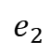
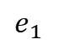
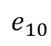
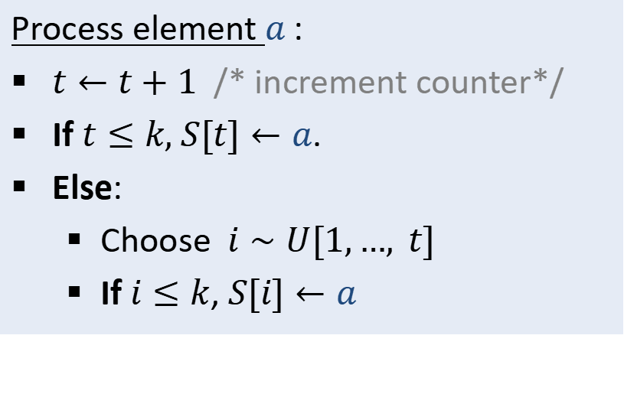
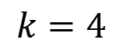

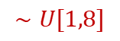
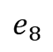
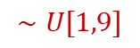
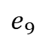
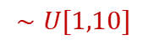
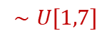
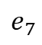
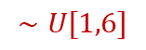
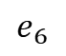
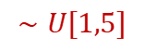
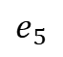
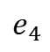
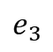
Reservoir Sampling [Knuth 1969,1981; Vitter 1985]
Uniform sample of $k$ data elements (all $k$-subsets equally likely)
Streaming sketch
Input: Stream of (unique) data elements: $a_{1},a_{2},…$
Initialize: Declare empty array $S\left[1\right],…,S\left[k\right]$ of elements; initialize counter $t←0$
Process element $a$:
$t←t+1$ /* increment counter*/
If $t≤k,$ $S[t]←a$.
Else:
Choose $i∼U[1,…, t]$
If $i≤k$, $S[i]←a$
$$k=4$$
$$∼U[1,6]$$
$$∼U[1,8]$$
$$∼U[1,10]$$
$$∼U[1,5]$$
$$∼U[1,7]$$
$$∼U[1,9]$$
1
6
7
5
2
4
$$e_{1}$$
$$e_{2}$$
$$e_{3}$$
$$e_{4}$$
$$e_{5}$$
$$e_{6}$$
$$e_{7}$$
$$e_{8}$$
$$e_{9}$$
$$e_{10}$$
$$×$$
$$×$$
$$×$$

Slide 9
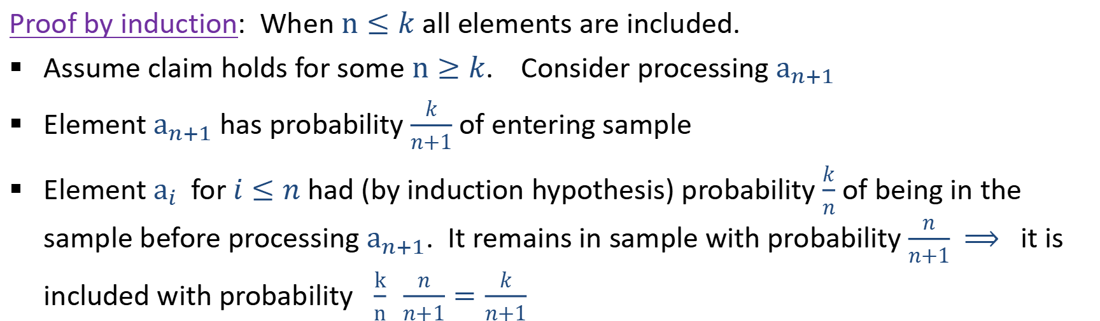
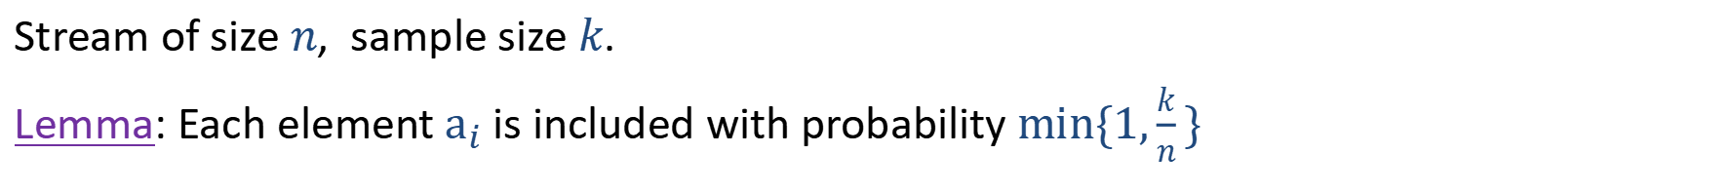
Reservoir sampling: Correctness
Stream of size $n$, sample size $k$.
Lemma: Each element $a_{i}$ is included with probability $min\{1,\frac{k}{n}\}$
Proof by induction: When $n≤k$ all elements are included.
Assume claim holds for some $n≥k$. Consider processing $a_{n+1}$
Element $a_{n+1}$ has probability $\frac{k}{n+1}$ of entering sample
Element $a_{i}$ for $i≤n$ had (by induction hypothesis) probability $\frac{k}{n}$ of being in the sample before processing $a_{n+1}$. It remains in sample with probability $\frac{n}{n+1}$ $⟹$ it is included with probability $\frac{k}{n} \frac{n}{n+1}=\frac{k}{n+1}$
!! All $k$ subsets equally likely: inclusion/exclusion does not depend on who else is there and where in the array. Can also argue by induction.

Slide 10
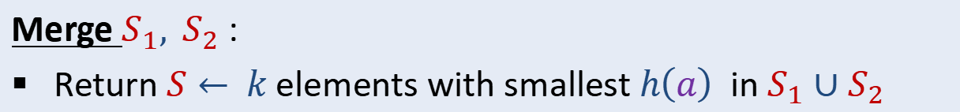
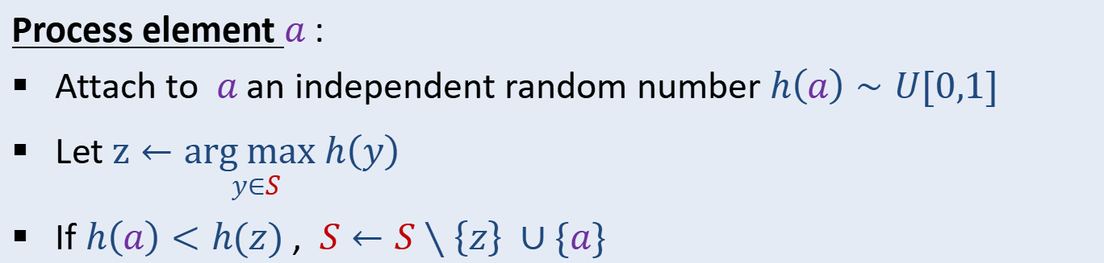
Uniform “bottom-$k$” Sampling [Knuth 1969,…]
Sample of $k$ data elements (all $k$-subsets equally likely)
“bottom-$k$”: The $k$ elements with smallest $h\left(a\right)$
*Why another method? composable, generalizes to distinct sampling, weighted sampling
Input: Data elements: $a_{1},a_{2},…$
Initialize: Empty set $S$ that can hold at most $k$ elements
Process element $a$:
Attach to $a$ an independent random number $h\left(a\right)∼U[0,1]$
Let $\underset{y∈S}{z←arg max h\left(y\right)}$
If $h\left(a\right)<h(z)$ , $S←S∖\left\{z\right\} ∪\{a\}$
Merge $S_{1}, S_{2}$:
Return $S←$ $k$ elements with smallest $h\left(a\right)$ in $S_{1}∪S_{2}$

Slide 11
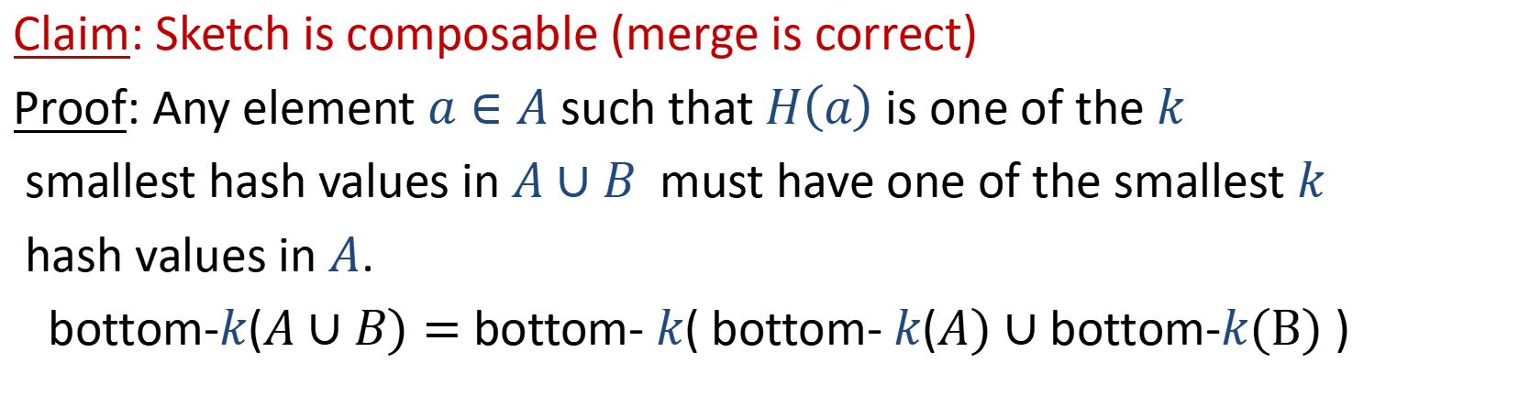
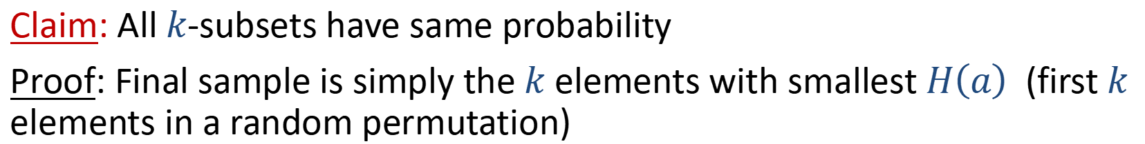

Uniform “bottom-$k$” sampling: Correctness
Claim: All $k$-subsets have same probability
Proof: Final sample is simply the $k$ elements with smallest $H\left(a\right)$ (first $k$ elements in a random permutation)
Claim: Sketch is composable (merge is correct)
Proof: Any element $a∈A$ such that $H\left(a\right)$ is one of the $k$
smallest hash values in $A∪B$ must have one of the smallest $k$
hash values in $A$.
bottom-$k$($A∪B)=$ bottom- $k$( bottom- $k$($A)∪$ bottom-$k\text{(}\text{B}\text{)}$ )
Notes:
Composable: We don’t need to know the sample size in advance

Slide 12
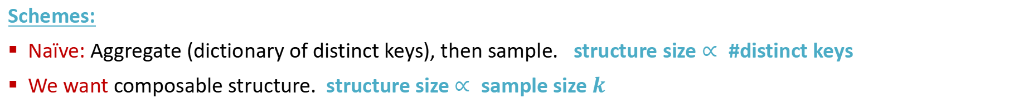
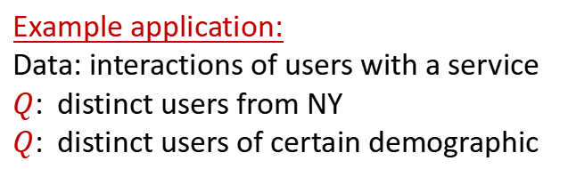
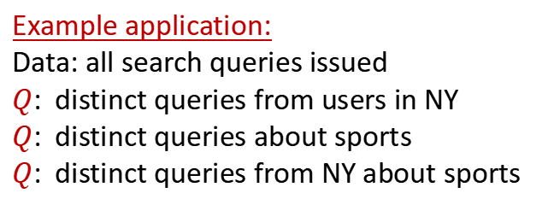
Uniform distinct sampling
Distinct sampling: A (uniform at random) $k$-subset of distinct keys
Distinct keys:
Example application:
Data: all search queries issued
$Q$: distinct queries from users in NY
$Q$: distinct queries about sports
$Q$: distinct queries from NY about sports
Example application:
Data: interactions of users with a service
$Q$: distinct users from NY
$Q$: distinct users of certain demographic
Schemes:
Naïve: Aggregate (dictionary of distinct keys), then sample. structure size $∝$#distinct keys
We want composable structure. structure size $∝$sample size $k$
Notes:
Some keys occur many times, different locations. But we are interested in statistics over distinct keys. So want a uniform sample over distinct keys. Each distinct key has same probability to be included, even if it appears many times.
Data is distributed or streamed in an arbitrary order, keys frequencies can be skewed

Slide 13
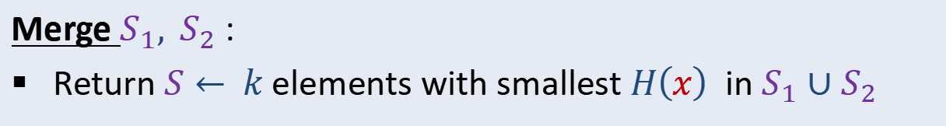
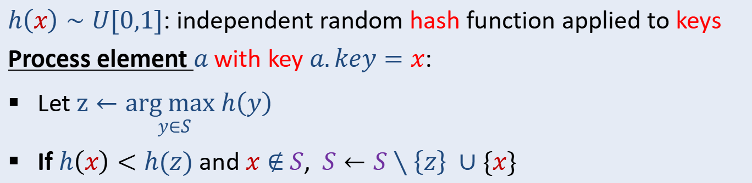
”bottom-k” distinct sampling
Initialize: Empty set $S$ that can hold at most $k$ elements
keys
Merge $S_{1}, S_{2}$:
Return $S←$ $k$ elements with smallest $H\left(x\right)$ in $S_{1}∪S_{2}$
keys
$h\left(x\right)∼U[0,1]$: independent random hash function applied to keys
Process element $a$with key $a.key=x$:
Let $\underset{y∈S}{z←arg max h\left(y\right)}$
If $h\left(x\right)<h(z)$ and $x∉$ $S$, $S←S∖\left\{z\right\} ∪\{x\}$
Correctness proofs are the same as data elements sampling, update efficiency: well get to soon
Caution: Uniform sample but we do not know population size!!
Can estimate proportion in domain, but can not estimate domain sizes
Notes:
Hashing idea introduced by computer scientists.

Slide 14
Distinct counting
Multiple data elements may have the same key, return #distinct keys.
Distinct keys:
24 data elements
11 distinct keys
Example applications:
Number of distinct search queries issued
Number of distinct users of a set of services
Number of distinct source IP addresses
Number of distinct source-destination pairs
Exact counting: Aggregate (build dictionary or hash table of distinct keys) structure size $∝$#distinct keys
Can we do better (allowing for approximation)?
Notes:
Some keys occur many times, different locations. But we are interested in statistics over distinct keys. So want a uniform sample over distinct keys. Each distinct key has same probability to be included, even if it appears many times.
Data is distributed or streamed in an arbitrary order, keys frequencies can be skewed

Slide 15
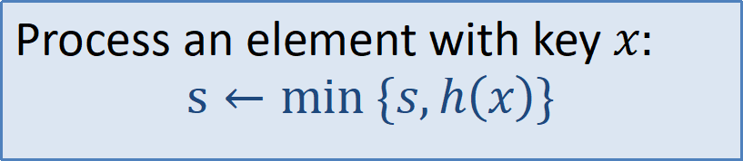
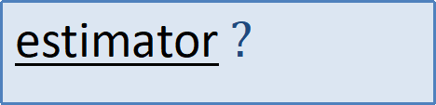
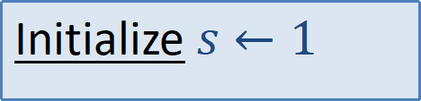
Distinct Keys: Approximate Counting
Idea: MinHash cardinality estimation: [Flajolet-Martin 85, C 94]
Same as distinct bottom-1 sampling, but maintain only the MinHash value $s$
$h\left(x\right)∼U[0,1]$ random hash function that maps keys to uniform random numbers in $[0,1]$
Initialize $s←1$
Process an element with key $x:$
$$s←min \{s,h\left(x\right)\}$$
estimator $?$

Slide 16
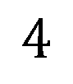
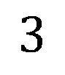


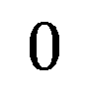
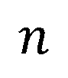
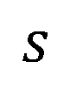
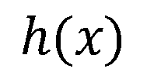









Relating the MinHash value and the distinct count
$$x$$
$$n$$
$$0$$
$$1$$
$$2$$
$$3$$
$$3$$
$$4$$
$$4$$
$$4$$
$$4$$
$$5$$
$$5$$
$$6$$
$$h(x)$$
$$0.45$$
$$0.35$$
$$0.74$$
$$0.45$$
$$0.21$$
$$0.35$$
$$0.45$$
$$0.21$$
$$0.14$$
$$0.35$$
$$0.92$$
$$s$$
$$1$$
$$0.45$$
$$0.14$$
$$0.14$$
$$0.35$$
$$0.35$$
$$0.35$$
$$0.21$$
$$0.21$$
$$0.21$$
$$0.21$$
$$0.14$$
The MinHash value $s$ depends only on $h$ and the set of distinct keys:
Distribution of $s$ (for $h∼H)$ only depends on the number of distinct keys $n$.

Slide 17




…Relating the MinHash value and the distinct count
The distribution of the MinHash value $s=min h\left(x\right)$ depends only on the number of distinct keys $n$.
$$0$$
$$1$$
minhash
The expectation of the minimum is $E\left[min h\left(x\right)\right]=\frac{1}{n+1}$
But variance is high. So we work with sketches that maintain $k≥1$ values
Notes:
Why expectation is 1/n+1 ? Close to a circle. Throw a random point for to cut into a line. Throw another n points. Expected gap between any two points is 1/(n+1).
Even before proposing and analyzing estimators, we can guess that this one minimum value carries limited information. So we can get very limited accuracy on the size estimate. We can boost this information by keeping k such registers.

Slide 18



Why expectation is $\frac{1}{n+1}$?
$$h(x)$$
Take a circle of length 1
Throw a random red point to “mark” the start of a segment of length $1$ (circle points map to $[0,1]$ )
Put $n$ more points at positions $h(x)$ for $x∈D$
The circle is cut into $n+1$ segments by these $n+1$ random points.
The expected length of each segment is $\frac{1}{n+1}$
Same also for the segment clockwise from the red point (min hash)

Slide 19



The MinHash Sketch Variety
Sketch maintains $k$ hash values $s_{1},s_{2},…,s_{k}$
k-mins sketch: Use $k$ “independent” hash functions: $h_{1},h_{2},…,h_{k}$
Track the respective minimum $s_{1},s_{2},…,s_{k}$ for each function.
Bottom-k sketch: One hash function: $h$
Track the $k$ smallest values $s_{1},s_{2},…,s_{k}$
!!Same as our distinct sampler,
Keep only hash values…
k-partition sketch: Use a single hash function: $h′$
Use the first $\log_{2} k$ bits of $h′(x)$ to map $x$uniformly to one of $k$ parts. Call the remaining bits $h(x)$.
For $i=1,…,k$: Track the minimum hash value $s_{i}$ of the elements in part $i$.
All sketch types are the same for $k=1$.
Sketch depends only on set of distinct keys and $h$. Distribution only depends on $n$
All sketches correspond to distinct sampling schemes

Slide 20
























$k$-mins MinHash Sketch: Example
$k$-mins $k=3$, $n=6$
$$x$$
$$h_{1}(x)$$
$$0.45$$
$$0.35$$
$$0.74$$
$$0.21$$
$$0.14$$
$$0.92$$
$$h_{2}(x)$$
$$0.19$$
$$0.51$$
$$0.07$$
$$0.70$$
$$0.55$$
$$0.20$$
$$h_{3}(x)$$
$$0.10$$
$$0.71$$
$$0.93$$
$$0.50$$
$$0.89$$
$$0.18$$
$${(s}_{1},s_{2},s_{3})=( , , )$$
$$0.14$$
$$0.07$$
$$0.10$$
Distinct sample: The keys with the MinHash values (with replacement sampling)
Notes:
Further applications: in data summarization, we have control over the scheme we apply. Good to keep these options in mind.
Say that for some applications we need to maintain meta information on the k elements contributing to the Min-hash sketch.
These k elements can be viewed as a sample of the set. K-mins are independent samples with replacement. Bottom-k is order sampling (without replacement sampling). k-partition is to partition and sample.

Slide 21





$k$-mins MinHash Sketch
k-mins sketch: Use $k$ “independent” hash functions: $h_{1},h_{2},…,h_{k}$
Track the respective minimum $s_{1},s_{2},…,s_{k}$ for each function.
Processing element with key $x$:
For $i=1,…,k$ : $s_{i}←min\{ s_{i},h_{i}\left(x\right)\}$
$$h_{1}\left(x\right)=0.35$$
$$h_{2}\left(x\right)=0.51$$
$$h_{3}\left(x\right)=0.71$$
Computation: $O(k)$ When sketch is modified or is not.

Slide 22







$k$-partition MinHash Sketch: Example
$k$-partition $k=3$, $n=6$
$$x$$
$$i(x)$$
$$2$$
$$3$$
$$1$$
$$1$$
$$2$$
$$3$$
part-hash
$$h(x)$$
$$0.19$$
$$0.51$$
$$0.07$$
$$0.70$$
$$0.55$$
$$0.20$$
value-hash
$${(s}_{1},s_{2},s_{3})=( , , )$$
$$0.07$$
$$0.19$$
$$0.20$$
Distinct sampler: The keys with the minhash values
HyperLogLog: Common distinct counter in industry uses $k$-partition structure
Notes:
Further applications: in data summarization, we have control over the scheme we apply. Good to keep these options in mind.
Say that for some applications we need to maintain meta information on the k elements contributing to the Min-hash sketch.
These k elements can be viewed as a sample of the set. K-mins are independent samples with replacement. Bottom-k is order sampling (without replacement sampling). k-partition is to partition and sample.

Slide 23



$k$-partition MinHash Sketch
k-partition sketch: Use a single hash function: $h′$
Use the first $\log_{2} k$ bits of $h′(x)$ to map $x$uniformly to one of $k$ parts. Call the remaining bits $h(x)$.
For $i=1,…,k$: Track the minimum hash value $s_{i}$ of the elements in part $i$.
Processing element with key $x$:
$i←first\log_{2} k \text{bits} \text{of} h′(x)$
$h←remaining \text{bits} \text{of} h′(x)$
$s_{i}← min\{s_{i},h\}$
$$i\left(x\right)=2$$
$$h\left(x\right)=0.19$$
$$s_{2}← min\{s_{2},0.19\}$$
Computation: $O(1)$ to test or update

Slide 24



Bottom- $k$Min-Hash Sketch: Example
Bottom-$k$ $k=3, n=6$
$$x$$
$$h(x)$$
$$0.19$$
$$0.51$$
$$0.07$$
$$0.70$$
$$0.55$$
$$0.20$$
$${(s}_{1},s_{2},s_{3})=( , , )$$
$$0.07$$
$$0.19$$
$$0.20$$
Distinct sampler: The keys with bottom-$k$ hash values
Notes:
Further applications: in data summarization, we have control over the scheme we apply. Good to keep these options in mind.
Say that for some applications we need to maintain meta information on the k elements contributing to the Min-hash sketch.
These k elements can be viewed as a sample of the set. K-mins are independent samples with replacement. Bottom-k is order sampling (without replacement sampling). k-partition is to partition and sample.

Slide 25





Bottom- $k$MinHash Sketch
Bottom-k sketch: One hash function: $h$
Track the $k$ smallest values $s_{1}<s_{2}<⋯<s_{k}$
Processing element with key $x$:
If $h\left(x\right)<s_{k}$ and $h\left(x\right)∉\{s_{1},…,s_{k}\}$: $(s_{1},…,s_{k})←sort{\{s}_{1},…, s_{k−1},h(x)\}$
Computation:
The sketch ${(s}_{1},…, s_{k})$ is maintained as a sorted list or as a priority queue.
$O(log k)$ to test if an update is needed
$O(k)$ to update a sorted list. $O(log k)$ to update a priority queue.
Different cost if sketch is modified or not!
We will see that #modification $≪$ #distinct elements

Slide 26


MinHash Sketches: Number of modifications
Lemma: The expected number of updates that modified the MinHash sketch is $O(k ln n)$
The number of times sketch is modified is linear in $k$ but is logarithmic in the number of distinct keys.
Why is it interesting to bound #modifications?
Sometimes modifications cost more than testing: With bottom-k sketches, or with parallel updates (“write” more expensive than “read”)
Later on we will see applications where it makes sense to record the “full history” of changes (that is, be able to obtain the sketch for any prefix of the stream).

Slide 27








MinHash Sketches: Number of modifications
Lemma: The expected number of updates that modified the MinHash sketch is $O(k ln n)$
Proof: First Consider $k=1$. Look at distinct keys in the order they first appear.
The $i$^{th} distinct key has lower hash value than the current minimum with probability $\frac{1}{i}$ . This is the probability of being first in a random permutation of $i$ keys.
$⟹$Total expected number of updates is $\sum_{i=1}^{n}{\frac{1}{i}=H_{n} }≤ ln n$.
Update
Prob.
$$\frac{1}{2}$$
$$\frac{1}{3}$$
$$\frac{1}{4}$$
$$\frac{1}{5}$$
$$\frac{1}{6}$$
$$1$$
$$0$$
$$0$$
$$0$$
$$0$$
$$0$$

Slide 28

MinHash Sketches: Number of updates
Lemma: The expected number of updates that modified the MinHash sketch is $O(k ln n)$
Proof (continued): Same idea as for $k=1$
$k$-mins: $k$ minhash values (apply $k$ times)
$k$-partition: $k$ minhash values for $≈n/k$ distinct values.
Bottom-$k$: We keep the $k$ smallest hash values. The $i$^{th} distinct key is in the bottom-$k$ with probability $min\{1,\frac{k}{i}\}$ so $\sum_{i=1}^{n}{\frac{k}{i}≤{kH}_{n} }≤kln n$ (probability of being in the first $k$ in a random permutation)

Slide 29

Composability of MinHash Sketches
!! We apply the same set of hash function to all elements/data sets/streams.
Merge $s$’,$s’’$ to obtain $s$
$k$-mins: entry-wise min (per hash function) $s_{i}←min \{s_{i}^{′},s_{i}^{′′} \}$
$k$-partition: entry-wise minimum (per part) $s_{i}←min \{s_{i}^{′},s_{i}^{′′} \}$
Bottom-$k$: ${\{s}_{1}, …,s_{k}\}=bottomk\{s_{1}^{′},…,s_{k}^{′}, s_{1}^{′′},…,s_{k}^{′′}\}$

Slide 30

Cardinality estimation from MinHash Sketches
The sketch content is a random variable that only depends on the number $n$of distinct keys. We estimate $n$ from the sketch
We study several estimators and derivation methods:
Maximum Likelihood Estimator (MLE)
Unbiased estimators
Understanding optimality:
Quick overview of tools from estimation theory: CRLB, sufficient statistics
Inverse probability estimator for bottom-$k$ sketches
Historic Inverse Probability Estimators for all (universal, $\frac{1}{2}$ the variance)
*Why so many methods? Important problem. But we also use it to introduce more general important concepts
Notes:
When estimating anything from a sketch we try to use the information we have in the best possible way: maximize its value. The sketch is all what could afford to keep or transmit from the original data that we want to query.

Slide 31


The Exponential Distribution $Exp(n)$
PDF $ne^{−nx}, x≥0$ ; CDF $1−e^{−nx}$ ; $μ=σ=\frac{1}{n}$
Very useful properties:
Memorylessness:
$∀t,y ≥0, Pr\left[X−y >t \right| X>y]=$ $Pr\left[X>t\right]$
Min-to-Sum conversion:
$$min\left\{Exp\left(n_{1}\right),…,Exp\left(n_{t}\right)\right\}∼Exp(n_{1}+⋯+n_{t})$$
Relation with uniform:
$u∼U\left[0,1\right] ⇔−\frac{ln\left(1−u\right)}{n}∼Exp(n)$
$$x∼Exp(n)⇔1−e^{−nx}∼U\left[0,1\right]$$
Notes:
Memorylessness: Given that X is larger than some y, the probability that it is larger than y+t is equal to the initial probability that it is larger than t (radioactive decay)
Note that the relations to uniform are monotone probability u<t = probability –ln(1-u) < -ln(1-t)

Slide 32


Cardinality estimation for $k$-mins MinHash Sketch
Convert to exponential distribution $h\left(x\right)∼Exp(1)$
Using Min-to-Sum property, $s_{i}∼Exp(n)$
Note that we can just work with $h\left(x\right)∼U[0,1]$ and convert the minhash to EXP: $s_{i}←−ln\left(1−s_{i}\right)$
We get a parameter estimation problem:
Given $k$ independent samples from $∼Exp[n]$ , estimate $n$
Notes:
Note that the relations to uniform are monotone probability u<t = probability –ln(1-u) < -ln(1-t)

Slide 33

Maximum Likelihood Estimation
Distribution $F_{θ}$ parameterized by $θ$.
We have $y∼F_{θ}$ and want to estimate the parameter $θ$ from $y$
The MLE ${\hat{θ}}_{MLE}$ is the maximizer of the likelihood (density) function $f(y;θ)$: The maximum over $θ$ of the probability of observing $y$ when the parameter is $θ$
Properties:
Principled way of deriving estimators
Converges in probability to true value (with enough i.i.d samples)… but generally biased
(Asymptotically…) optimal – minimizes MSE (mean square error)
Notes:
“Niruut Maximalit”
Likelihood and density are the same function but we think of them differently. Fixed parameter and distribution over y versus fixed y and distribution over the parameter theta.
Example: Our sketch is a random variable that depends on the number of distinct keys

Slide 34


ML Cardinality estimator for $k$-mins MinHash Sketch
Given $k$ independent samples from $Exp(n)$ , estimate $n$
Likelihood function for our sketch $y=\left\{s_{i}\right\}$ (joint density function):
$$f\left(\{s_{i}\};n\right)=\prod_{i=1}^{k}{ne^{−ns_{i}}=}n^{k}e^{−n\sum_{i=1}^{k}{s_{i}}}$$
Take a logarithm (does not change the maximum):
$$ℓ\left({\{s}_{i}\} ;n\right)=log f\left({\{s}_{i}\};n\right)=k ln n −n\sum_{i=1}^{k}{s_{i}}$$
Differentiate to find maximum: $\frac{∂ℓ\left(\{s_{i}\};n\right)}{∂n}=\frac{k}{n}−\sum_{i=1}^{k}{s_{i}=0}$
MLE estimate ${\hat{n}}_{MLE}=\frac{k}{\sum_{i=1}^{k}{s_{i}}}$
Estimator depends only on the sum!

Slide 35




ML Cardinality estimator for $k$-mins MinHash Sketch
MLE estimate ${\hat{n}}_{MLE}=\frac{k}{\sum_{i=1}^{k}{s_{i}}}$
$x=\sum_{i=1}^{k}{s_{i}}$ , the sum of $k$ i.i.d $∼Exp(n)$random variables) is Erlang distributed with PDF
$$f_{k,n}(x)=ne^{−nx}\frac{{\left(nx\right)}^{k−1}}{\left(k−1\right)!}$$
The expectation of the MLE estimate is
$${E[\hat{n}}_{MLE}]=\int_{0}^{∞}{\frac{k}{x}f_{k,n}}\left(x\right)dx=\frac{k}{k−1}n$$
$×\frac{k−1}{k}$ to get unbiased estimator!
Notes:
We now look at the bias of this estimator. To do that, it convenient to work with the distribution of the sum (one vaiable)

Slide 36



Unbiased Cardinality estimator for $k$-mins Sketch
Unbiased Estimator $\hat{n}=\frac{k−1}{\sum_{i=1}^{k}{s_{i}}}$ (for $k>1$)
The variance of the unbiased estimate is
$$σ^{2}=\int_{0}^{∞}{\frac{{\left(k−1\right)}^{2}}{x^{2}}f_{k,n}}\left(x\right)dx−n^{2}=\frac{1}{k−2}n^{2}$$
The CV is $\frac{σ}{μ}=\frac{1}{\sqrt{k−2}}$
Is this the best we can do? How do we know?

Slide 37

Our parameter estimation problem:
Given $k$ independent samples from $Exp[n]$ , estimate $n$
Our MLE and our unbiased estimator use the sum of the samples $s_{1},s_{2},…,s_{k}$
But… We can think of multiple reasonable estimators from our $k$ samples $s_{1},s_{2},…,s_{k}$:
average (sum)
median
remove outliers and average remaining, …
How can we tell that we found the best estimator? (get the most value (minimum MSE) from the information we have (the sketch)).
Notes:
The MLE, and also out unbiased estimators use the sum

Slide 38
Cramér-Rao lower bound (CRLB)
Are we using the information in the sketch in the best possible way ?

Slide 39

Cramér-Rao lower bound (CRLB)
Information theoretic lower bound on the variance of any unbiased estimator $\hat{θ}$ of $θ$.
Likelihood function: $f\left(y;θ\right)$
Log likelihood:
$$ℓ\left(y;θ\right)=ln f\left(y;θ\right)$$
Fisher Information
$$I\left(θ\right)=−E_{y∼F_{θ}}\left[\frac{∂^{2}ℓ\left(y;θ\right)}{∂θ^{2}}\right]$$
CRLB: Any unbiased estimator has $V\left(\hat{θ}\right)≥\frac{1}{I\left(θ\right)}$

Slide 40


CRLB for estimating $n$ from $y=\left\{s_{i}\right\}$
Likelihood function for $n,y=\left\{s_{i}\right\}$
$$f\left(y;n\right)=\prod_{i=1}^{k}{ne^{−ns_{i}}=}n^{k}e^{−n\sum_{i=1}^{k}{s_{i}}}$$
Log likelihood $ℓ\left(y;n\right)=kln n−n\sum_{i=1}^{k}{s_{i}}$
Negated second derivative: $\frac{∂^{2}ℓ\left(y;n\right)}{∂^{2}n}=−\frac{k}{n^{2}}$
Fisher information: $I\left(n\right)=−E_{y∼F_{n}}[\frac{∂^{2}ℓ\left(y;n\right)}{∂^{2}n}]=\frac{k}{n^{2}}$
CRLB : $var\left[\hat{n}\right]≥\frac{1}{I\left(n\right)}=\frac{n^{2}}{k}$

Slide 41



Cardinality estimator for $k$-mins Sketch
Unbiased Estimator $\hat{n}=\frac{k−1}{\sum_{i=1}^{k}{s_{i}}}$ (for $k>1$)
CV $\frac{σ}{n}=\frac{1}{\sqrt{k−2}}$
The Cramér-Rao lower bound on CV is $\frac{1}{\sqrt{k}}$
$⇒$ Our estimator uses the information in the sketch nearly optimally!

Slide 42
Sufficient statistics
Another useful tool when searching for estimators

Slide 43


Sufficient Statistic
A function $T\left(y\right)$ is a sufficient statistic for estimating (some function of) the parameter $θ$ if the likelihood function has the factored form $c\left(y\right)g(T\left(y\right);θ)$
Likelihood function (joint density) for $k$ exponential i.i.d random variables from $Exp(n)$ :
$$f\left(\{s_{i}\};n\right)=\prod_{i=1}^{k}{ne^{−ns_{i}}=}n^{k}e^{−n\sum_{i=1}^{k}{s_{i}}}$$
$⇒$The sum $\sum_{i=1}^{k}{s_{i}}$ is a sufficient statistic for $n$
Notes:
What does estimation theory tells us about sufficient statistic ?

Slide 44


Sufficient Statistic
A function $T\left(y\right)$ is a sufficient statistic for estimating (some function of) the parameter $θ$ if the likelihood function has the factored form $f\left(y;θ\right)=c\left(y\right)g(T\left(y\right),θ)$
Lemma: The MLE always depends on$y$ only through $T(y)$
MLE is $arg \max_{θ}f\left(y;θ\right)=arg \max_{θ} g\left(T\left(y\right),θ\right)$
The gradient $\frac{∂g\left(T\left(y\right),θ\right)}{∂θ}$ is a function of T$\left(y\right)$.

Slide 45


Rao-Blackwell Theorem
Recap: $T\left(y\right)$ is a sufficient statistic for $θ⟺$ Conditional distribution of $y$ given $T(y)$ does not depend on $θ$
Rao-Blackwell Theorem: Given an estimator $b(y)$ of $θ$that is not a function of the sufficient statistic, we can get an estimator with at most the MSE of $b(y)$ that depends only on $T(y)$: $E[b(y)|T(y)]$
Enough to look at estimators that are functions of the sufficient statistics
Notes:
The estimator $E[b(y)|T(y)]$ is well define (does not depend on parameter) because of conditional property.
Rao-Blackwellization: a way to get a better estimator

Slide 46



Cardinality Estimation from a Bottom-$k$ Sketch
Bottom-$k$ sketch $s_{1}<s_{2}<⋯<s_{k}$
Can we specify the distribution?
$k=1$ same as $k$-mins $s_{1}∼Exp[n]$
Given $s_{1}$, $s_{2}∼$ $Exp\left[n−1\right]| s_{2}>s_{1}.$ Since memoryless, ${s_{2}−s}_{1}∼Exp[n−1]$.
More generally ${s_{i+1}−s}_{i}∼Exp[n−i]$.
What is the relation with $k$-mins sketches?
Notes:
Show on board: to condition on > y_i, divide density by probabilty of being > y_i

Slide 47





Bottom-$k$ versus $k$-mins minhash sketches
Bottom-k sketch: samples from
$$Exp[n],Exp[n−1],…,Exp[n−k+1]$$
K-mins sketch: $k$samples from $Exp[n]$
To obtain $x∼Exp[n]$ from $z∼Exp[n−i]$ (without knowing $n$) we can take $x=min\{z,t\}$ where $t∼Exp[i]$
We can use $k$-mins estimators with bottom-$k$. (Can do even better by taking expectation over choices of $t$).
Bottom-$k$ sketches carry strictly more information than $k$-mins sketches!
Notes:
Show on board: to condition on > y_i, divide density by probabilty of being > y_i

Slide 48

Cardinality Estimation from a Bottom-$k$ Sketch
Likelihood function of $s_{1},…,s_{k},n$:
$$f\left(y;n\right)=\prod_{i=1}^{k}{\left(n+1−i\right)e^{−(n+1−i)(s_{i}−s_{i−1})}=}$$
$$\frac{n!}{\left(n−k\right)!} e^{−(n+1)\sum_{i=1}^{k}{{(s}_{i}−s_{i−1})}}e^{\sum_{i}^{k}{i\left(s_{i}−s_{i−1}\right) }}=$$
$${=e}^{ky_{k}−\sum_{i=1}^{k−1}{s_{i} }}\frac{n!}{\left(n−k\right)!}e^{−\left(n+1\right)s_{k}}$$
Does not depend on n
Depends on n
What does estimation theory tell us?

Slide 49


Cardinality Estimation from a Bottom-$k$ Sketch
What does estimation theory tell us?
Likelihood function
$$f\left(y;n\right){=e}^{ks_{k}−\sum_{i=1}^{k−1}{s_{i} }}\frac{n!}{\left(n−k\right)!}e^{−\left(n+1\right)s_{k}}$$
$s_{k}$ (maximum value in the sketch) is a sufficient statistic for estimating $n$ (or any function of $n$ ).
Captures everything we can glean from the bottom-k sketch on $n$

Slide 50




Bottom-$k$: MLE for Distinct Count
Likelihood function (probability density) is
$$f\left(y;n\right){=e}^{ks_{k}−\sum_{i=1}^{k−1}{s_{i} }}\frac{n!}{\left(n−k\right)!}e^{−\left(n+1\right)s_{k}}$$
Find the value of $n$ which maximizes $f\left(y;n\right)$ :
Look only at part that depends on $n$
Take the logarithm (same maximum)
$$ℓ\left(y;n\right)=\sum_{i=0}^{k−1}{ln(n−i)}−\left(n+1\right)s_{k}$$

Slide 51




Bottom-$k$: MLE for Distinct Count
We look for $n$ which maximizes
$$ℓ\left(y;n\right)=\sum_{i=0}^{k−1}{ln(n−i)}−\left(n+1\right)s_{k}$$
$$\frac{∂ℓ\left(y;n\right)}{∂n}=\sum_{i=0}^{k−1}{\frac{1}{n−i}}−y_{k}$$
$$\sum_{i=0}^{k−1}{\frac{1}{n−i}}=s_{k}$$
MLE is the solution of:
Need to solve numerically
Notes:
Recall that s_k here is the exponential incarnation: transform the uniform minimum u by –ln(1-u)

Slide 52


Inverse probability estimators [Horvitz Thompson 1952]
Model: We have an element with value $v≥0$ that is sampled (and observed) with probability $p$
The Inverse Probability Estimator $\hat{v}$ for $v$is:
If $v$ is sampled $\hat{v}=\frac{v}{p}$.
Else, $\hat{v}=0$
$\hat{v }$ is unbiased:$E\left[\hat{v}\right]=\left(1−p\right)⋅0+p\frac{v}{p}=v$
$Var\left[\hat{v}\right]=E\left[{\hat{v}}^{2}\right]−v^{2}=p{\left(\frac{v}{p}\right)}^{2}+\left(1−p\right)0^{2}−v^{2}=v^{2}(\frac{1}{p}−1)$
Note: We need to know $p$ and $v$ when the element is sampled.
* this is the minimum variance nonnegative unbiased estimator
Notes:
comment: this is the minimum variance nonnegative unbiased estimator

Slide 53



Bottom-$k$ Inverse probability estimator
We use random hash function $h\left(x\right)∼U[0,1]$
Each distinct key $x$ has “presence” $A_{x}=1$ if there is at least one element with the key and $A_{x}=0$ otherwise. The distinct count
$$n=\sum_{x∈X}{A_{x}}$$
is the sum of the presence of all keys.
We construct an estimator $\hat{A_{x}}≥0$ for $A_{x}$. We can then estimate the distinct count
$$\hat{n}=\sum_{x}{\hat{A_{x}}}=\sum_{x |\hat{A_{x}}>0}{\hat{A_{x}}}$$
As sum of presence estimates (it suffices to sum the strictly positive estimates)
We will use inverse probability estimates $\hat{A_{x}}$ for $A_{x}$: If $x$ is observed (“sampled”), the estimate is $\frac{A_{x}}{p_{x}}=\frac{1}{p_{x}}$ . Otherwise $\hat{A_{x}}=0$

Slide 54



Bottom-$k$ Inverse probability estimator
Inverse probability estimates $\hat{A_{x}}$ for the presence $A_{x}∈\{0,1\}$: If $x$ is observed (“sampled”), the estimate is $\frac{A_{x}}{p_{x}}=\frac{1}{p_{x}}$ . Otherwise $\hat{A_{x}}=0$
We consider a key “sampled” if it has one of the bottom $k−1$ hash values.
The probability $p_{x}$ that $x$ is sampled: $p_{x}=\frac{k−1}{n}$ , but we do not know $n$ !!
We instead compute $p_{x}$ conditioned on fixed $h$ on $X∖\left\{x\right\}$ but taking $h\left(x\right)∼U\left[0,1\right]$
$x$ is sampled $⟺h\left(x\right)<{(k−1)}^{th}\left(h\left(z\right)|z∈N∖\{x\}\right)$
${⟹p}_{x}=$(${k−1)}^{th}\left(h\left(z\right)|z∈N∖\{x\}\right)$
$=s_{k}$ when $x$ is sampled
$⟹$Inverse probability estimate is $\hat{A_{x}}=\frac{1}{p_{x}}=\frac{1}{s_{k}}$
$$\hat{n}=\frac{k−1}{s_{k}}$$
Summing over the $k−1$ “sampled” keys:
CV is $\frac{σ}{μ}≤\frac{1}{\sqrt{k−2}}$ at least as good as the $k$-mins estimator (we don’t show)
Notes:
We know the presence value of sampled keys (must be 1). We need to know the probability to compute the estimate.
Positive estimates are only for the k-1 sampled keys.

Slide 55




Walking through conditioning for Inverse Probability Estimate for bottom-$k$
$$N=\{a,b,c,d,e\}$$
$$k=3$$
The probability $p$that $a$ is “sampled” is that it has one of the $k−1=2$ smallest values in $h\left(a\right),h\left(b\right), …,h\left(e\right)$: $p=$ $\frac{2}{5}$
But we can not compute $p$ because we do not know $n(=5)$.
So instead we use the conditional probability $p′=Pr\left[a∈S \right|h\left(b\right), …,h(e)]$. It is the $2^{nd}$ smallest value in $h\left(b\right), …,h\left(e\right).$
If $a$ is “sampled” then $p′$ is the $3^{rd}=k^{th}$ smallest in current sketch

Slide 56

Better distinct count estimators ?
Recap:
Our estimators ($k$-mins, bottom-$k$) have CV $\frac{σ}{μ}≤\frac{1}{\sqrt{k−2}}$
CRLB ($k$-mins) says CV $\frac{σ}{μ}≥\frac{1}{\sqrt{k}}$
Can we improve ? CRLB applies when we are limited to using only the information in the sketch.
Idea: Use information we discard along the way

Slide 57


“Historic” Inverse Probability (HIP) Estimators [C’ 15]
We maintain an approximate count $c$ in the sketch: $s_{1},…, s_{k} , c$
Initially $s_{1},…, s_{k}←(1,…,1)$ $c←0$
When processing of key $x$ would modify the sketch $s$, we compute the probability $p$of modification by a new distinct key.
We modify $s$ and increase the counter $c←c+\frac{1}{p}$
Easy to apply with all minhash sketches
The estimate is unbiased
We can (do not) show CV $\frac{σ}{μ}≤\frac{1}{\sqrt{2k−2}}<\frac{1}{\sqrt{2}}\frac{1}{\sqrt{k−2}}$
Notes:
Intuitively, this accounts for all distinct elements that did not get counted. Also, fixing hashes of all other distinct elements, this estimate has expectation 1 over randomization of the hash of all other elements.

Slide 58




$k$-mins “historic” minhash sketch
k-mins sketch: Use $k$ “independent” hash functions: $h_{1},h_{2},…,h_{k}$
Track the minhash values $s_{1},s_{2},…,s_{k}$ for each function.
Update probability: probability $p$ that at least for one $i=1,…,k,$ we get $h_{i}\left(x\right)<s_{i}$ :
$$p=1−\prod_{i}^{k}{(1−s_{i})}$$
Processing an element with key $x$:
$p←$ $1−\prod_{i}^{k}{(1−s_{i})}$
For $i=1,…,k$ : $s_{i}←min\{ s_{i},h_{i}\left(x\right)\}$
If $s$ was modified : $c←c+\frac{1}{p}$
Notes:
This is not the most efficient “code”. Do not need to actually recompute p for each element.

Slide 59



$k$-partition “historic” minhash sketch
Processing an element with key $x$:
$i←first\log_{2} k \text{bits} \text{of} h′(x)$
$h←remaining \text{bits} \text{of} h′(x)$
If $h<s_{i}$ ,
$p←\frac{1}{k}\sum_{j=1}^{k}{s_{j}}$ ,
$c←c+\frac{1}{p}$
$s_{i}← h$
Modification probability by a new key: probability $p$ that $h\left(x\right)<s_{i}$ for part $i$ selected uniformly at random
Notes:
可以考虑2个独立哈希函数，第一个哈希函数用来分桶，第2个哈希函数为具体的随机标签值，当一个元素要改变我们的sketch时，那么一定是它的哈希值比它映射到的分桶中的最小哈希值还要小。所以映射到一个桶中的概率为1/k, 比i桶中的哈希值还小的概率为si, 一共有K个这样的事件，当前仅当一个发生的概率即为s1/k+s2/k+…sk/k

Slide 60



bottom-$k$ “historic” minhash sketch
Bottom-$k$ sketch: Use a single hash function: h
Track the $k$ smallest values $s_{1}<s_{2}<…<s_{k}$
Processing an element with key $x$:
If $h\left(x\right)<s_{k}$ and $h\left(x\right)∉\{s_{1},…,s_{k}\}$:
$c←c+\frac{1}{s_{k}}$
$\left(s_{1},s_{2},…,s_{k}\right)←sort \{s_{1},s_{2},…,s_{k−1},h(x)\}$
Probability of a new key modifying the sketch is: $s_{k}$

